Slide 1
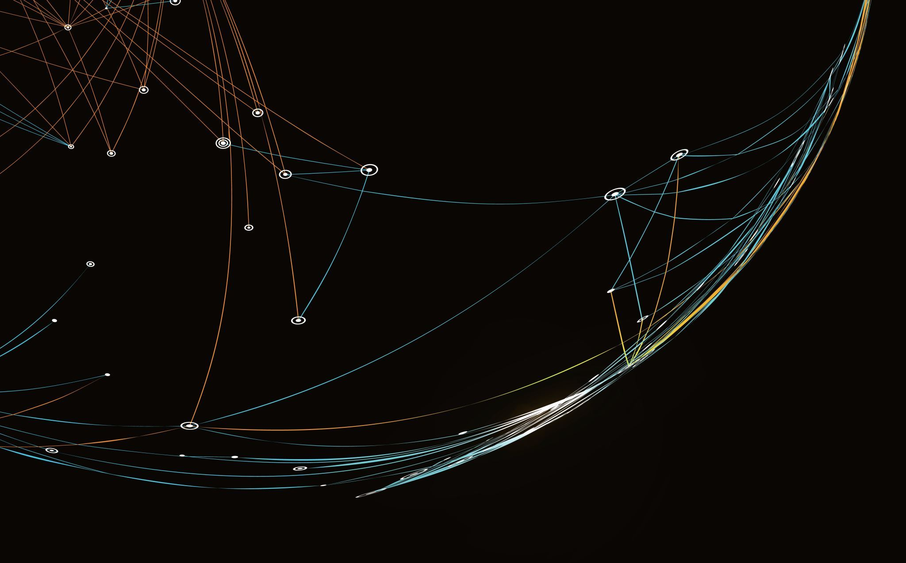

Time Series OOD Detection using Bayesian-optimized Normalizing Flows
Austin Coursey and Abel Diaz Gonzalez

Slide 2
Project Idea Recap
Original idea:
Use a conditioned autoregressive flow (Rasul et al., 2020), optimized using a form of deep Empirical Bayes to perform fault (anomaly) detection in a time series dataset
The Bayesian hyperparameter optimization method we consider might not be possible to use with RNN architectures (what the flow model relies on)
Interesting research problem to explore and find a solution
Shift project to only consider standard flow models that use MLPs

Slide 3













Normalizing flows
The goal is to describe the process that produces the data
$$Ω,p$$
$$z:base\left(simple,known\right) variable$$
$x:$ $target (complex,unknown) variable$
$$x$$
$$z$$
$$z=f\left(x\right)$$
$$f$$
$$X$$
$$Z$$
Sample: $x=f^{−1}(z)$
Prob density function : $p_{x}\left(x\right)=p_{z}\left(f\left(x\right)\right)\left|det\left(\frac{df\left(x\right)}{dx}\right)\right|$
$$p_{x}$$
$$p_{z}$$
$$\left|det\left(\frac{df(x)}{dx}\right)\right|$$
$$ℝ_{+}$$
$$ℝ_{+}$$
$f$ is invertible (bijection)
$f$ and $f^{−1}$ are differentiable functions ($f$ diffeomorphism)
$\left|det\left(\frac{df(x)}{dx}\right)\right|$ easy to compute
Change of
variable

Slide 4





Normalizing flows
$f\left(x\right)≈$ $f\left(x,ω\right)$
$$Ω,p$$
$$x$$
$$z$$
$$p_{x}\left(x\right) ≈p_{x}\left(x|ω\right)=p_{z}\left(f\left(x,ω\right)\right)\left|det\left(\frac{df\left(x,ω\right)}{dx}\right)\right|$$
$$f$$
$$\max_{ω}{\prod_{n=1}^{N}{p_{x}\left(x_{n}|ω\right)}}$$
$$X$$
$$Z$$
$$≈$$
$$\min_{ω}{d_{KL}(p_{x}\left(x\right)||p_{x}\left(x,ω\right))}$$
$$p_{x}$$
$$p_{z}$$
$$L\left(ω\right)≈−\frac{1}{N}\sum_{n=1}^{N}{log\left(p_{z}\left(f(x_{n};ω)\right)\right)+\log\left(\left|det\left(\frac{df\left(x_{n},ω\right)}{dx}\right)\right|\right)+const}$$
$$\left|det\left(\frac{df(x)}{dx}\right)\right|$$
$$ℝ_{+}$$
$$ℝ_{+}$$
Change of
variable

Slide 5
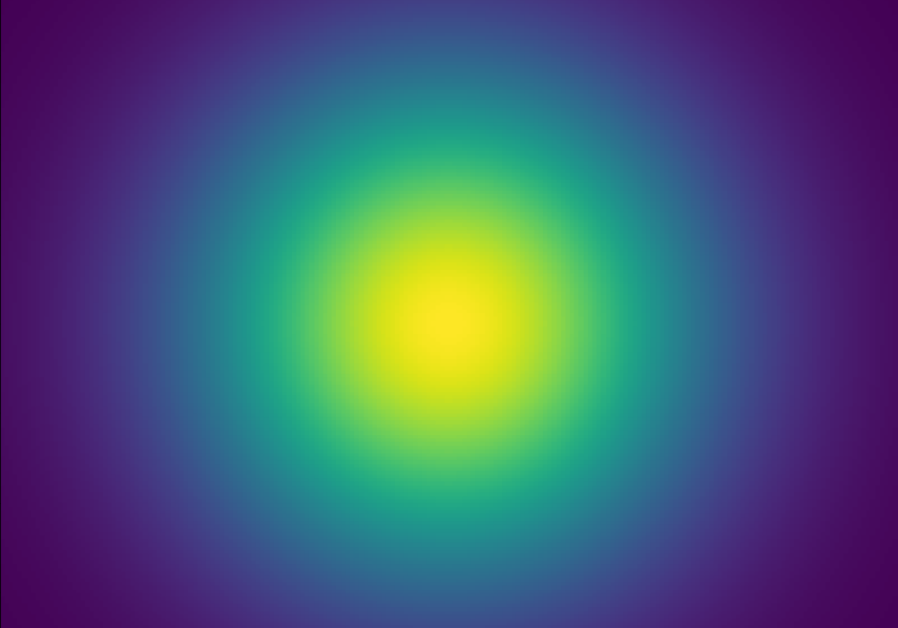
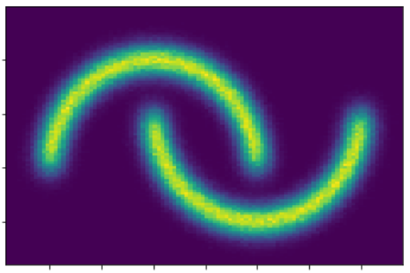
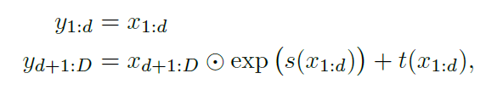












Normalizing flows
$$f$$
$$X$$
$$Z$$
$$f_{1}$$
$$f_{2}$$
$$f_{3}$$
…
$$f_{N}$$
Use simple transformations as building blocks
$$p_{x}$$
$$p_{z}$$
Affine coupling layers
$$ℝ_{+}$$
$$ℝ_{+}$$
$$f_{k}:$$

Slide 6
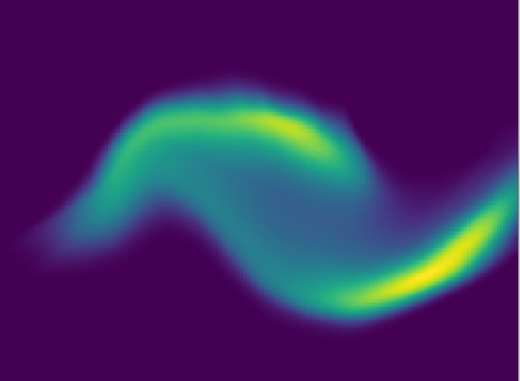
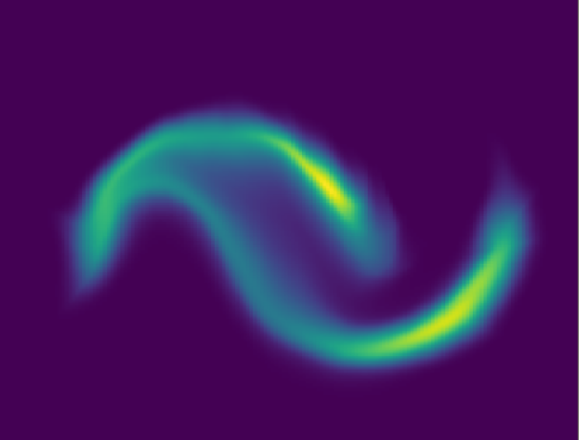
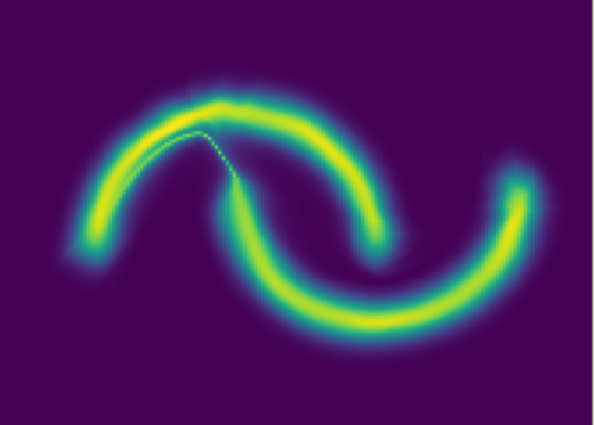






























Normalizing flows
$$p_{x}\left(x\right) ≈p_{x}\left(x|ω\right)=p_{z}\left(f\left(x;ω\right)\right)\left|det\left(\frac{df\left(x,ω\right)}{dx}\right)\right|$$
$$p_{x}\left(x|ω_{0}\right)$$
$$f\left(x,ω_{0}\right)$$
$$p_{z}$$
$$\left|det\left(\frac{df(x, ω_{0})}{dx}\right)\right|$$
$$X$$
$$Z$$
$$ℝ_{+}$$
$$p_{z}$$
$$p_{x}\left(x|ω_{250}\right)$$
$$f\left(x,ω_{250}\right)$$
$$\left|det\left(\frac{df(x,ω_{250})}{dx}\right)\right|$$
$$X$$
$$Z$$
$$ℝ_{+}$$
$$f\left(x,ω_{500}\right)$$
$$p_{z}$$
$$p_{x}\left(x|ω_{500}\right)$$
$$\left|det\left(\frac{df(x,ω_{500})}{dx}\right)\right|$$
$$X$$
$$Z$$
$$ℝ_{+}$$
$$⋮$$
$$p_{z}$$
$$p_{x}\left(x|ω_{4000}\right)$$
$$f\left(x,ω_{4000}\right)$$
$$\left|det\left(\frac{df(x,ω_{4000})}{dx}\right)\right|$$
$$X$$
$$Z$$
$$ℝ_{+}$$

Slide 7
NF for Anomaly Detection
Anomaly?
Anomaly?
Anomaly?

Slide 8
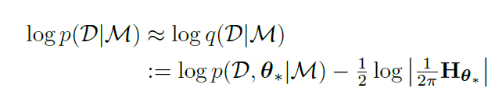







Bayesian optimization
Need to mention:
-Algorithm 1
-How it doesn't need validation data and why that is necessary here
Parameter optimization
$$\max_{ω}{\prod_{n=1}^{N}{p_{x}\left(x_{n}|ω\right)}}$$
$\max_{ω}{p_{x}\left(ω\left|\prod_{n=1}^{N}{x_{n}}\right.\right)}∝$ $\max_{ω}{p_{x}\left(\prod_{n=1}^{N}{x_{n}}\left|ω\right.\right)p(ω)}$
$$\min_{ω}{−\sum_{n=1}^{N}{\log\left(p_{x}\left(x_{n}\left|ω\right.\right)\right)−N}\log{p(ω)}}$$
$$\min_{ω} −\frac{1}{N}\sum_{n=1}^{N}{\left[log\left(p_{z}\left(f(x_{n};ω)\right)\right)+\log\left(\left|det\left(\frac{df\left(x_{n},ω\right)}{dx}\right)\right|\right)\right]−\log{p(ω)}}$$
Hyperparameter optimization (Immer et al., 2021)
$p$($𝔇$|$ℳ$)=$\int{p \text{(}𝔇\text{|}ω\text{)}p\text{(}ω\text{|}ℳ)dω}$
intractable for even medium-size neural-network models
Laplace method(Gaussian approximation)
$$ℳ:Hyperparameters$$
Prior on weights
Noise variance on marginal likelihood estimates
Hessian approx
Gauss-Newton (GGN)
Empirical Fisher (EF),
$$𝔇:Dataset$$

Slide 9

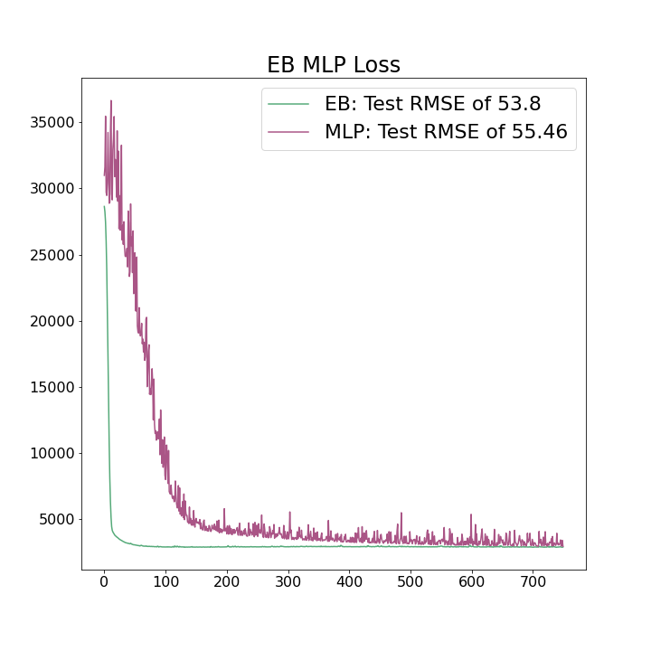
Bayesian optimization
MLP trained on classic "Diabetes" regression problem
Using Bayesian optimization:
Faster
More stable
Better performance

Slide 10
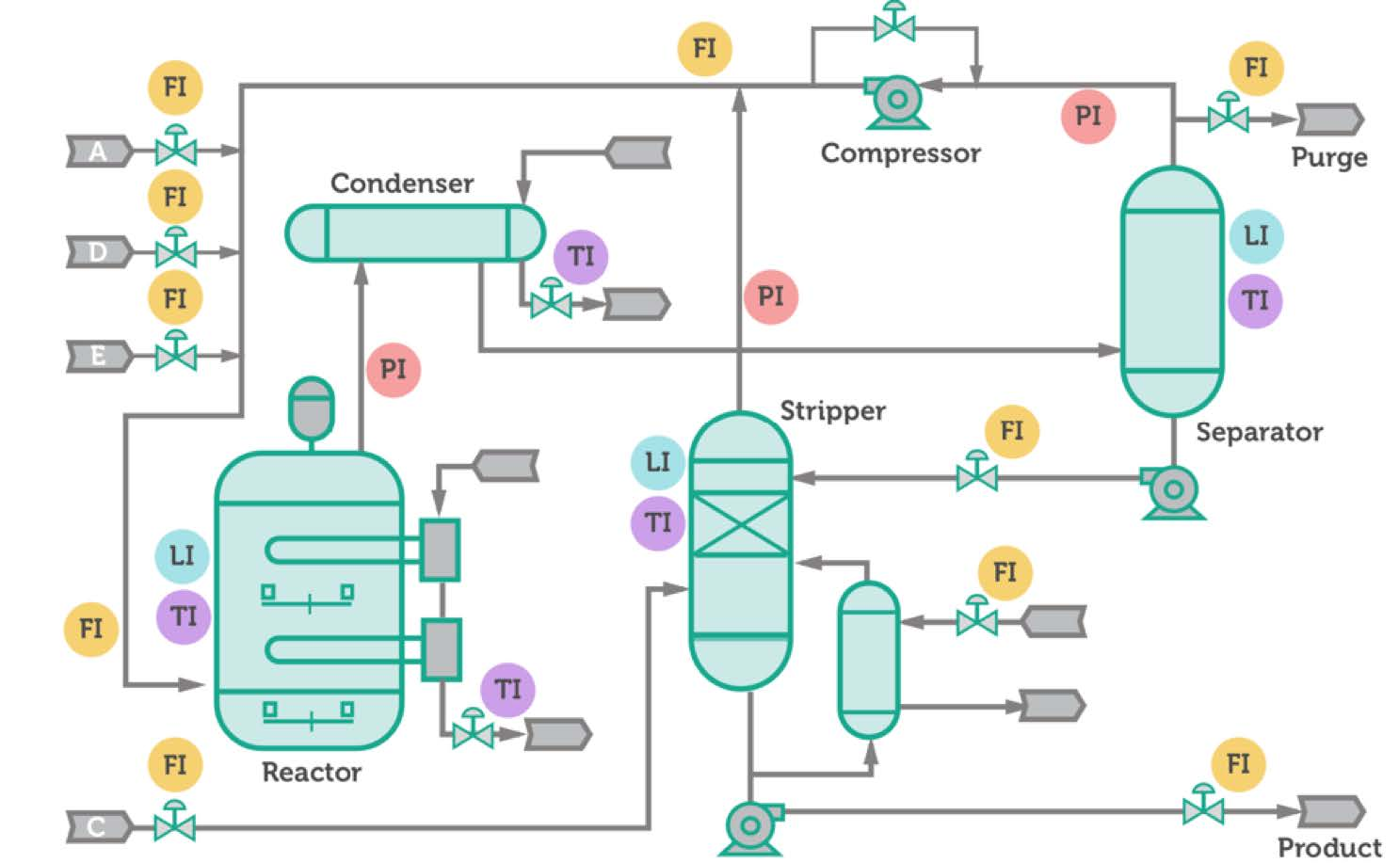
Data Recap
Tennessee Eastman Process benchmark dataset
https://dataverse.harvard.edu/dataset.xhtml?persistentId=doi:10.7910/DVN/6C3JR1
Simulated industrial process data
20 fault types
51 features
Popular fault detection dataset
https://keepfloyding.github.io/posts/Ten-East-Proc-Intro/

Slide 11

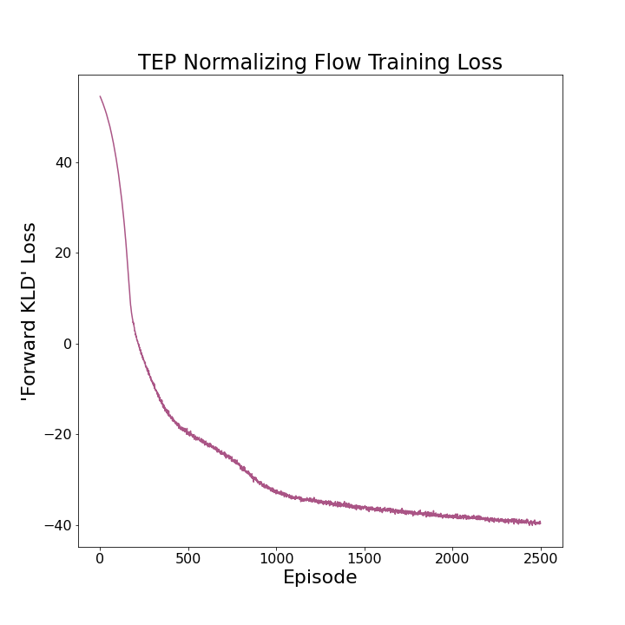

Normalizing Flow for TEP
Disregard time
Train RealNVP (Dinh et al., 2017) flows on fault-free (nominal) data
16 Flows
Affine Coupling
Each with own [64, 64] MLP
Unsupervised
Base – Diagonal Gaussian w/ dimension of data

Slide 12
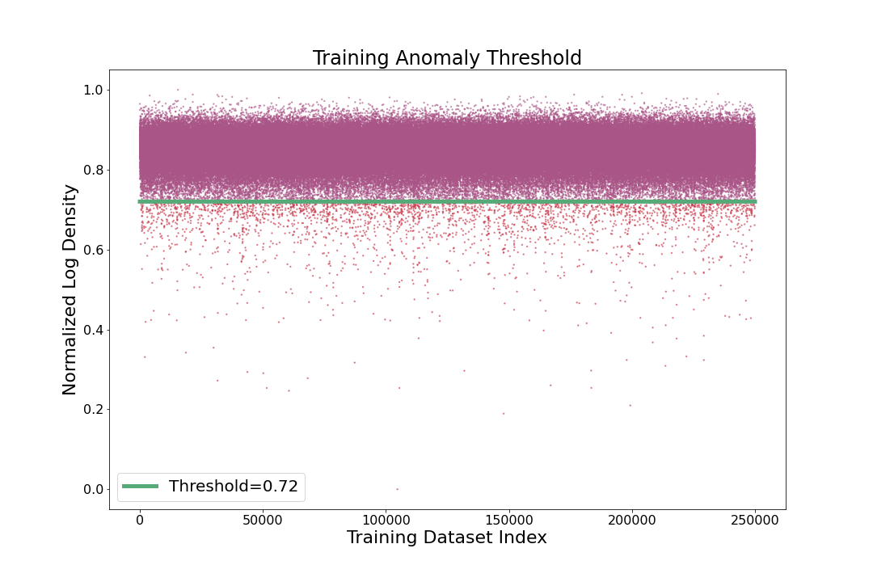
Anomaly Thresholding
Many ways to determine threshold for what density is an anomaly
ROC/AUC
If data is balanced
Lower density than minimum of training (Wei et al., 2022)
Lower density than standard deviations below mean
Intuitively, higher false positives (with training data) but more realistic

Slide 13
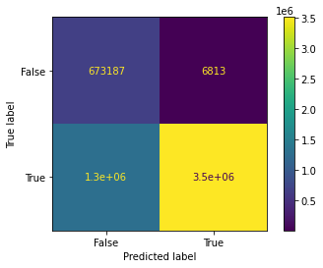
Anomaly Detection Results
~76% accuracy
Comparable to results in the literature
Not state-of-the-art
Competitive with some supervised methods
Few false positives – saves money
High false negatives

Slide 14
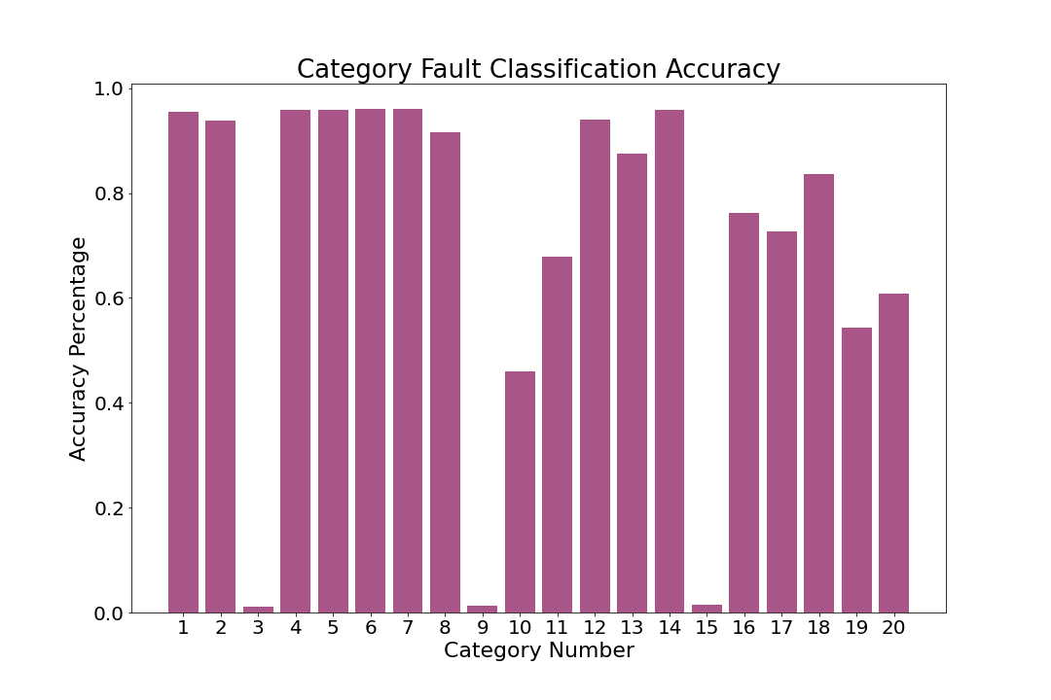
9 & 15 notorious

Slide 15
Combing NF and Bayesian Opt.
We can currently train the NF and optimize the hyperparameters (using MSE loss) associated with the MLP of each flow separately
Not what we want
To use EB on the whole flow model, we need to rewrite some aspects of the packages for Laplace approximation & Normalizing Flows
Backup: use a "black box" hyperparameter search
Ex: grid search over different number of flow layers, learning rates, etc.

Slide 16
Future Directions
Perform Empirical Bayes for flows that use RNNs
Incorporate time dependencies (ex. Oven temp.):
Apply these models to different tasks in this field
Don't see it often in the literature
Usually LSTM, Autoencoder, Vanilla NN, clustering, etc.
Fault diagnosis, RUL prediction
250°
300°
150°
375°
✓
✓
✓
✓

Slide 17
Thanks for listening! Questions?

